Slide 1
Hpcc systems
An introduction

Slide 2
Do these two records belong to the same person?
Record | First Name | Last Name | Address | City | State | Zip
1 | MARCIA | MARSUPIAL | 6035 JONES ST | ARVADA | CO | 80004
2 | KAREN | KANGAROO | 5865 W OHIO AVE | LAKEWOOD | CO | 80226

Slide 3

HPCC Systems (Small to Big Data) ETL
Integrate
Profile
Clean
Standardize
Aggregate
Machine Learning
Deliver
Decreasing Content Volume
Batch Services
Relate &
Big Data
Sources
Real-time Services
Profile & Clean
Standardize
Analyze
Visualization Integration
Increasing Content Quality
Unstructured and Structured Content
HPCC Systems Data Lake
Analysis Applications

Slide 4
The Data Centric Approach
A single source of data is insufficient to overcome inaccuracies
Our platform is built on the premise of absorbing data from many data sources and transforming them to actionable smart data

Slide 5
Do these two records belong to the same person?
Record | First Name | Last Name | Address | City | State | Zip
1 | MARCIA | MARSUPIAL | 6035 JONES ST | ARVADA | CO | 80004
2 | KAREN | KANGAROO | 5865 W OHIO AVE | LAKEWOOD | CO | 80226
Among the thousands of data sources, we found a series of related records
Matching Record 1
MARCIA | K | MARSUPIAL | 6035 |  | JONES | ST | ARVADA | CO | 80004
Moved
MARCIA | K | MARSUPIAL | 9170 | W | 14TH | AVE | LAKEWOOD | CO | 80226
Changed her last Name
MARCIA | K | KANGAROO | 9170 | W | 14TH | AVE | LAKEWOOD | CO | 80226
Changed Middle Initial as First Name
K | MARCIA | KANGAROO | 9170 | W | 14TH | AVE | LAKEWOOD | CO | 80226
Moved and matched Record 2
KAREN | MARCIA | KANGAROO | 5865 | W | OHIO | AVE | LAKEWOOD | CO | 80226

Slide 6
Technology — Layer View
Tools
Tombolo - Data Catalog
ECL IDE (Cloud/VS Code/Windows)
Visualization
ECL Watch – Admin Interface
Connectivity and Third-Party Tools
Analytics Libraries
Normalization
Batch Services
Profiling
Cleaning
Data Management
Spark
HDFS
ODBC/JDBC
Apache Kafka
MySQL Import
SQL Query Interface
Java API
Elastic Search
Distributed Parallel Machine Learning Library
Machine Learning
Common Language
ECL
Data Engines (Distributed Parallel Processing Support)
Thor cluster
ROXIE cluster
TensorFlow (Coming Soon)
Couchbase/MySQL/MariaDB

Slide 7
Use Case

Slide 8
The Challenge
Use Case: Insurance Collusion
Detecting hidden and comprehensive insurance claim fraud
The data only found connections between two of the seven claims — with one being weakly connected

Slide 9
The Solution
Use Case: Insurance Collusion
Family #1
Customers’ claim data
linked by LexisNexis® Risk Solutions sources and analyzed using HPCC Systems
Family #2

Slide 10
ECL Cloud IDE –Modern Developer Interface

Slide 11
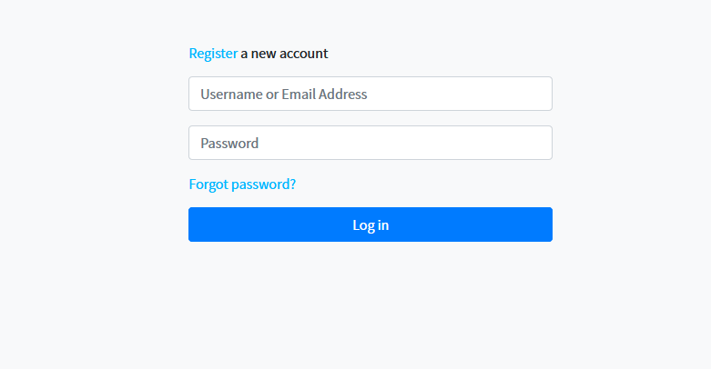
Login Page

Slide 12
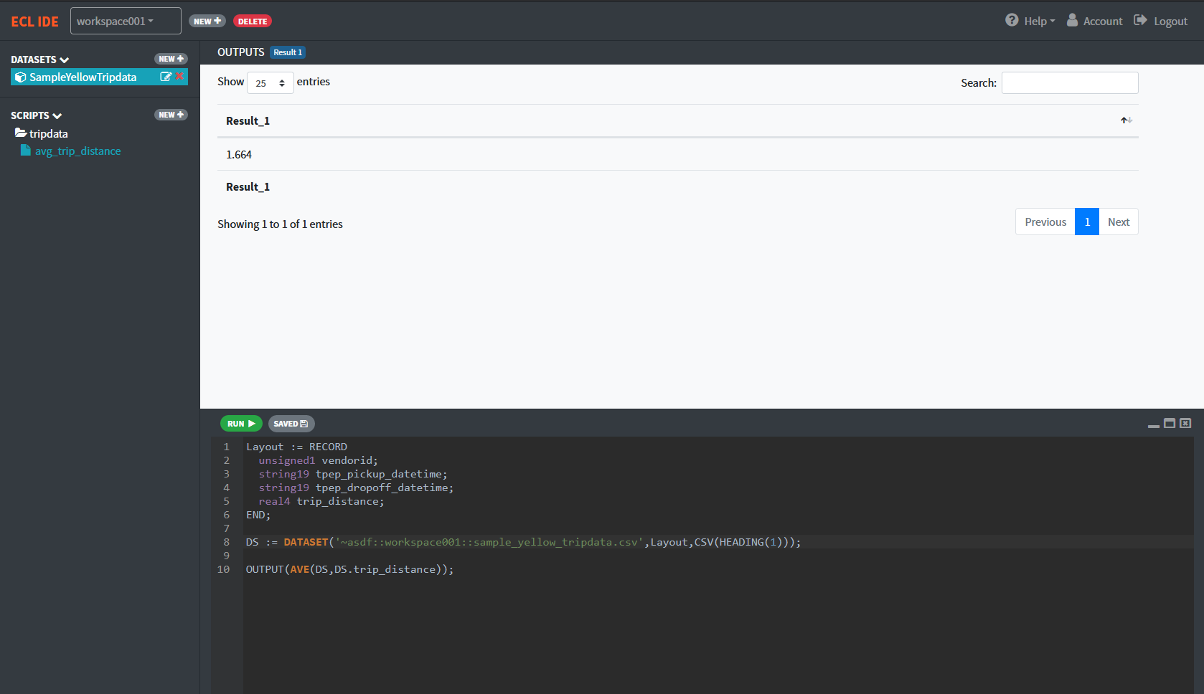
ECL Cloud Interface

Slide 13
MACHINE LEARNING

Slide 14
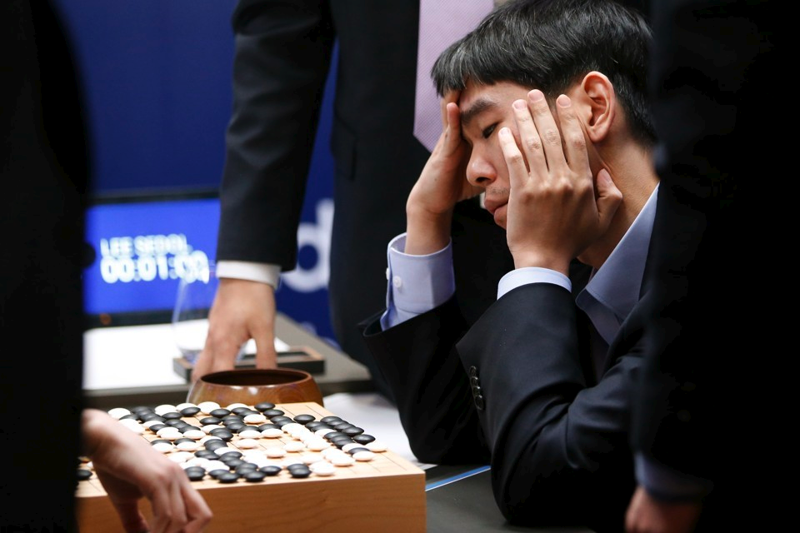
AlphaGo VS Best Human Player

Slide 15

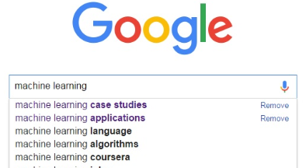


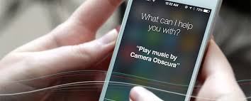
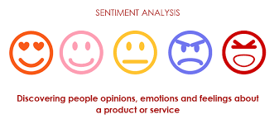
Machine Learning in Daily Life

Slide 16
HPCC SYSTEMS MACHINE LEARNING

Slide 17
Machine Learning on HPCC Systems Platform
ML_Core
LinearRegression
PBblas
LogisticRegression
K-Means
GLM
Core Bundle
SVM
LearningTrees
Algorithm Bundle
Notes:
ML_Core Provides the core data definitions and attributes for machine learning. ML_Core is a prerequisite for all HPCC Systems production machine learning bundles.
PBblas - Parallel Block Linear Algebra Subsystem Provides distributed, scalable matrix operations used by several of the other bundles. Can also be used directly whenever matrix operations are in order. This is a dependency for several of our production machine learning bundles

Slide 18
Using Machine Learning in HPCC Systems

Slide 19
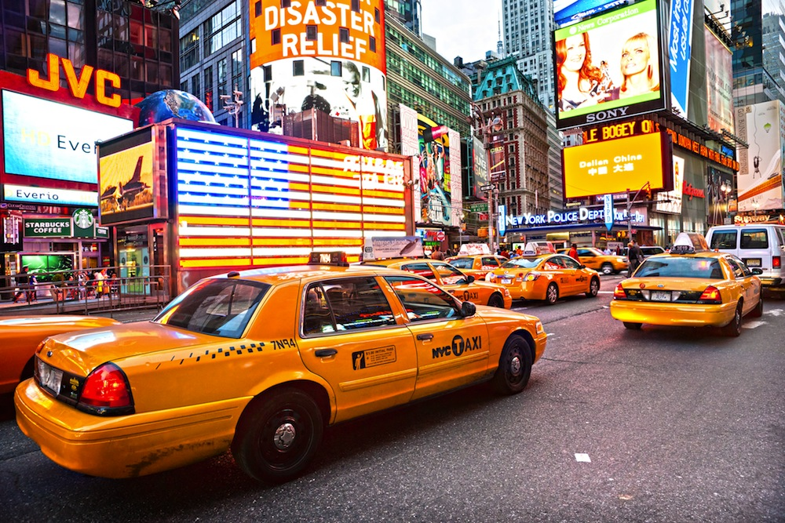
New York City Taxi Trips

Slide 20

Had I known, I would book a cab earlier

Slide 21
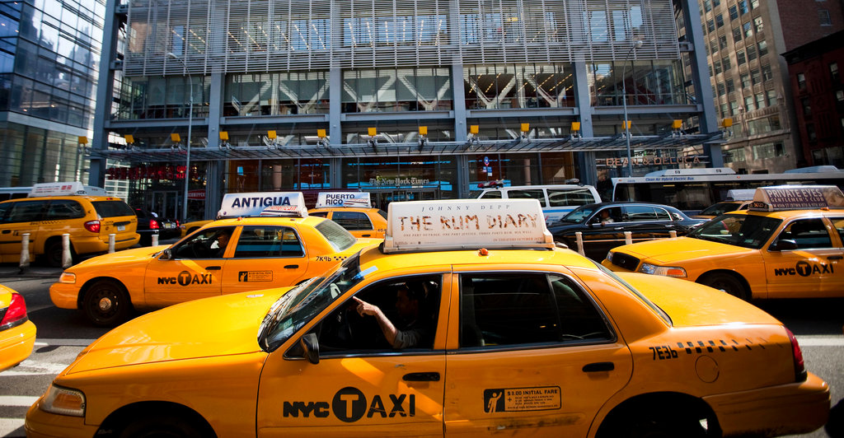
Prediction
NYC Taxi Data
48 GB
241M RECORDS
JAN 2015 – JUN 2016
16 MONTH
W/ WEATHER INFO
NOTE: The slides introduce you to a sample of the original dataset to keep the instructions simple and precise. The instructions to use the complete dataset is listed in the Appendix.

Slide 22
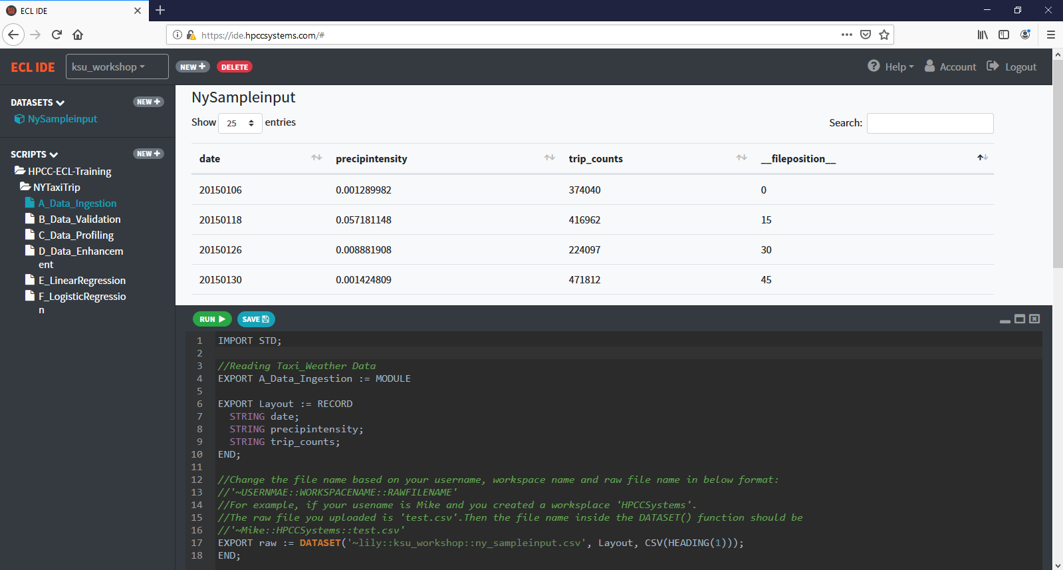
Data Ingestion

Slide 23
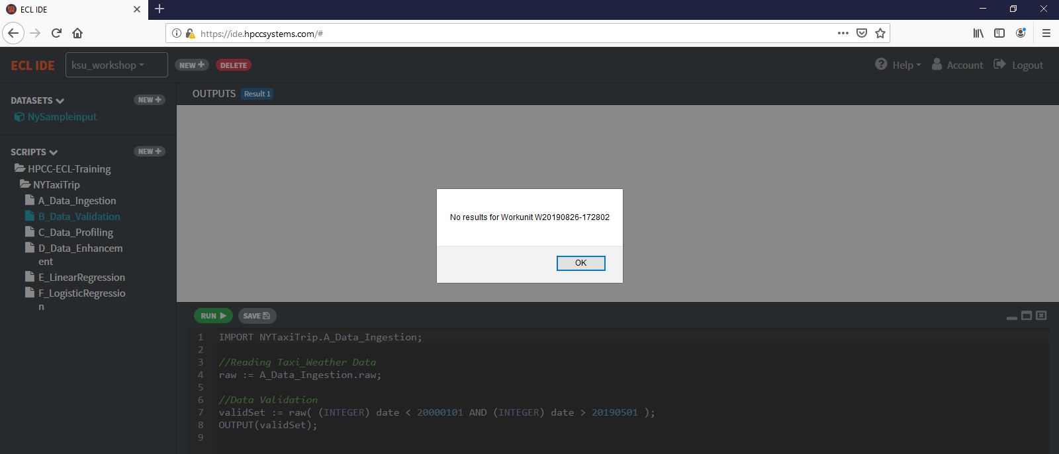
Data Validation

Slide 24
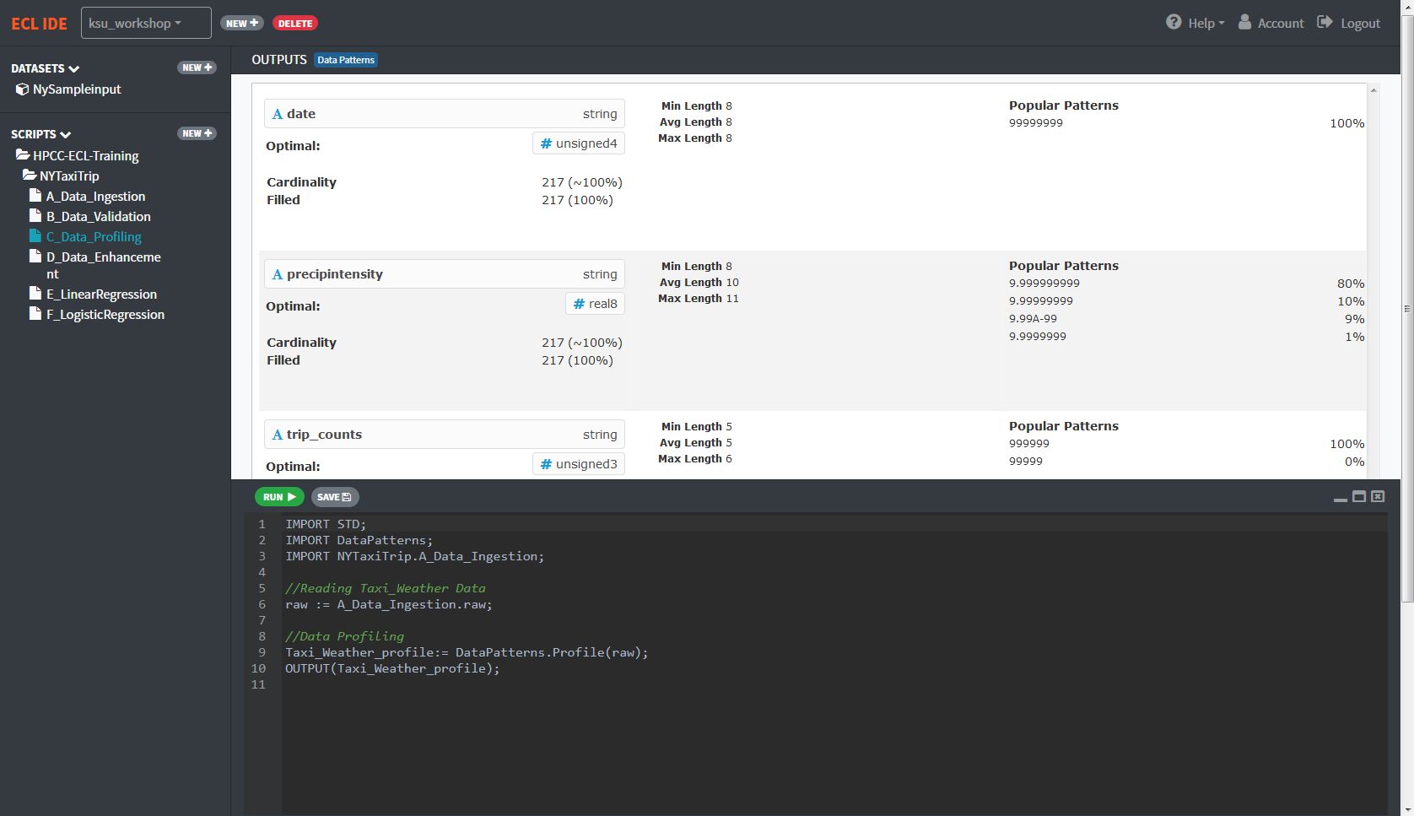
Data Profiling
Profile Result Example

Slide 25
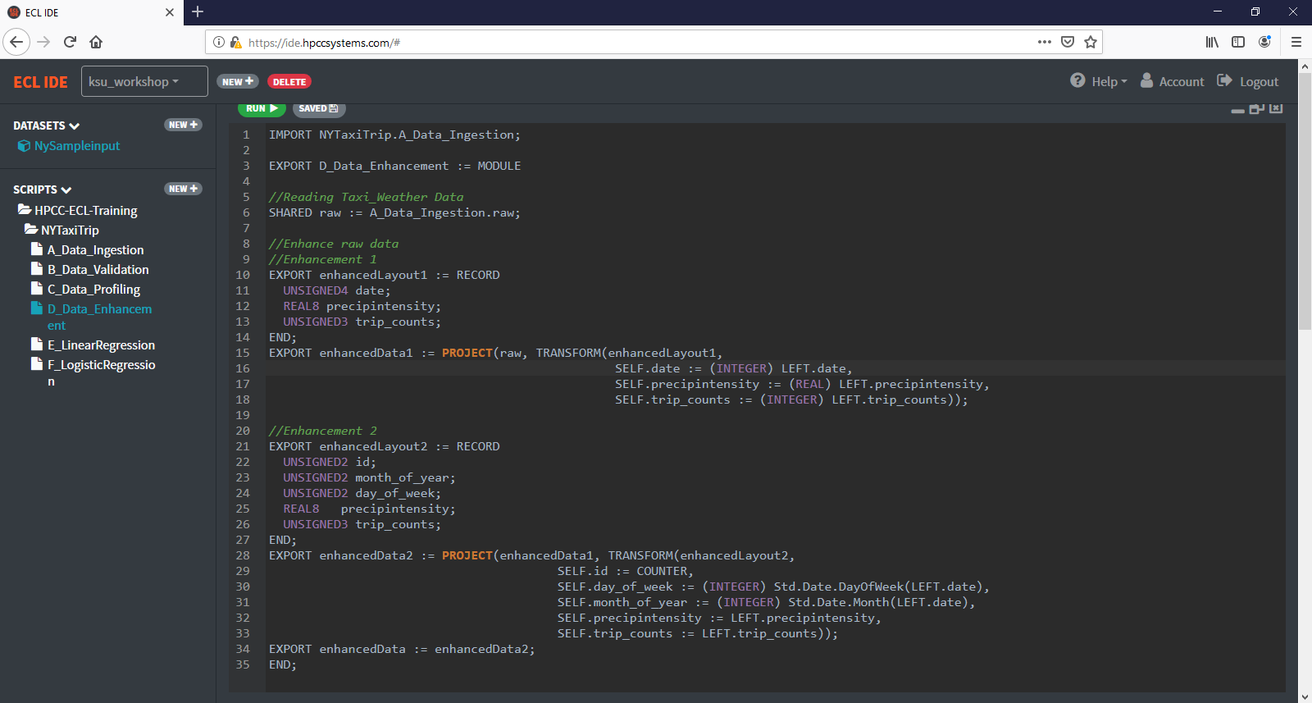
Data Enhancement

Slide 26
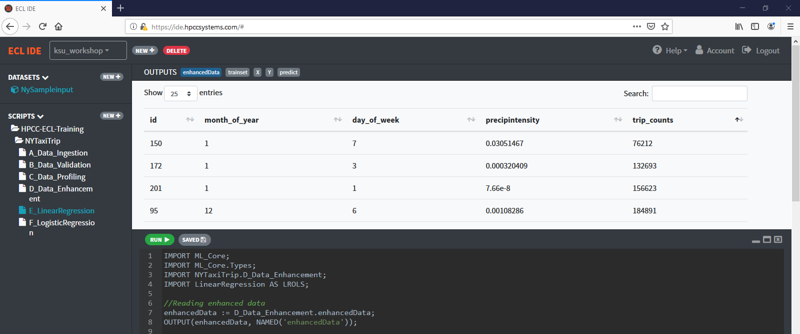
Linear Regression

Slide 27
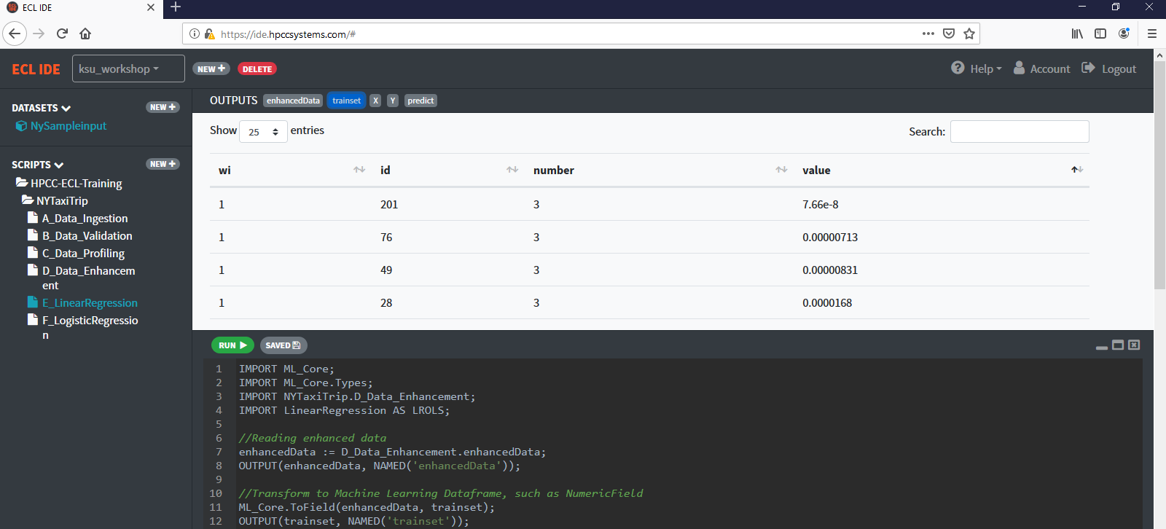
Linear Regression

Slide 28
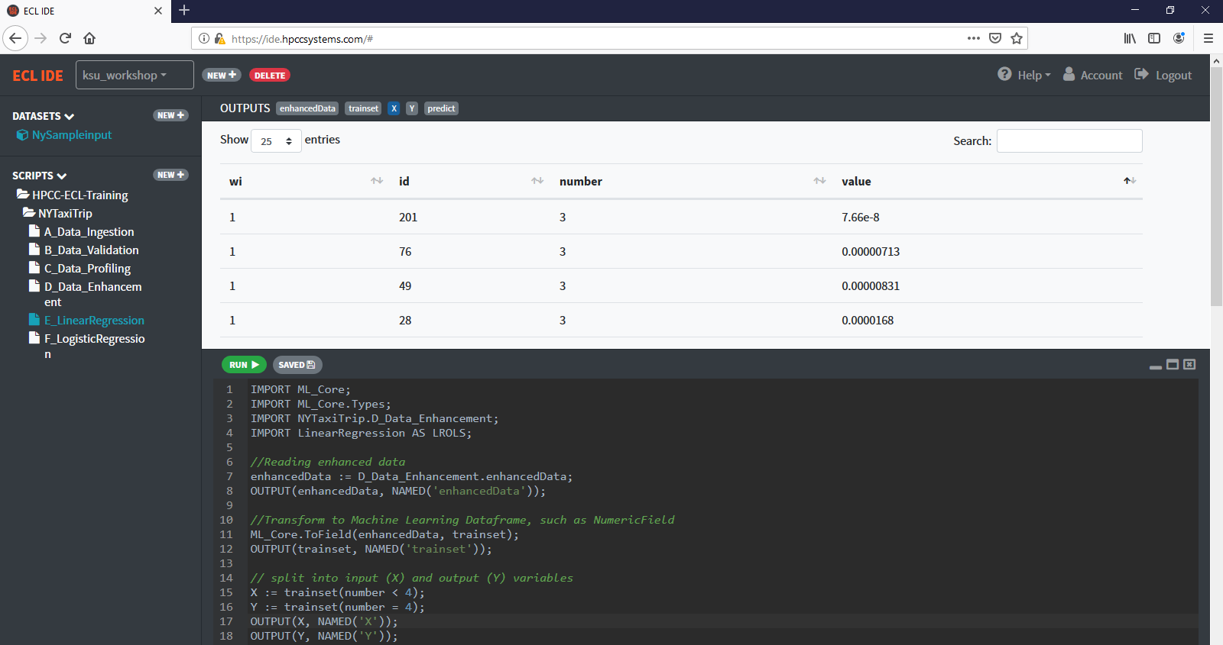
Linear Regression

Slide 29
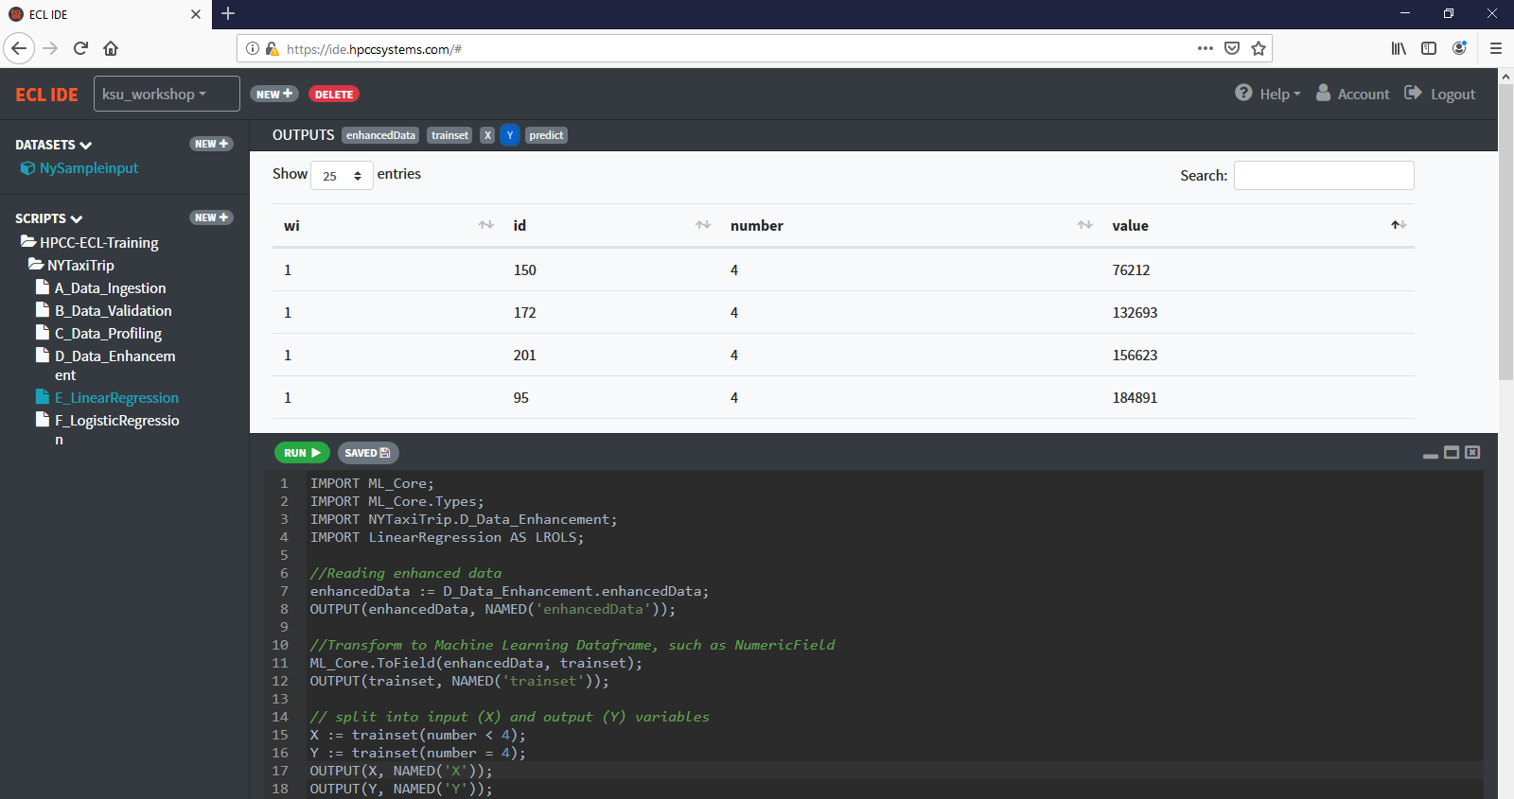
Linear Regression

Slide 30
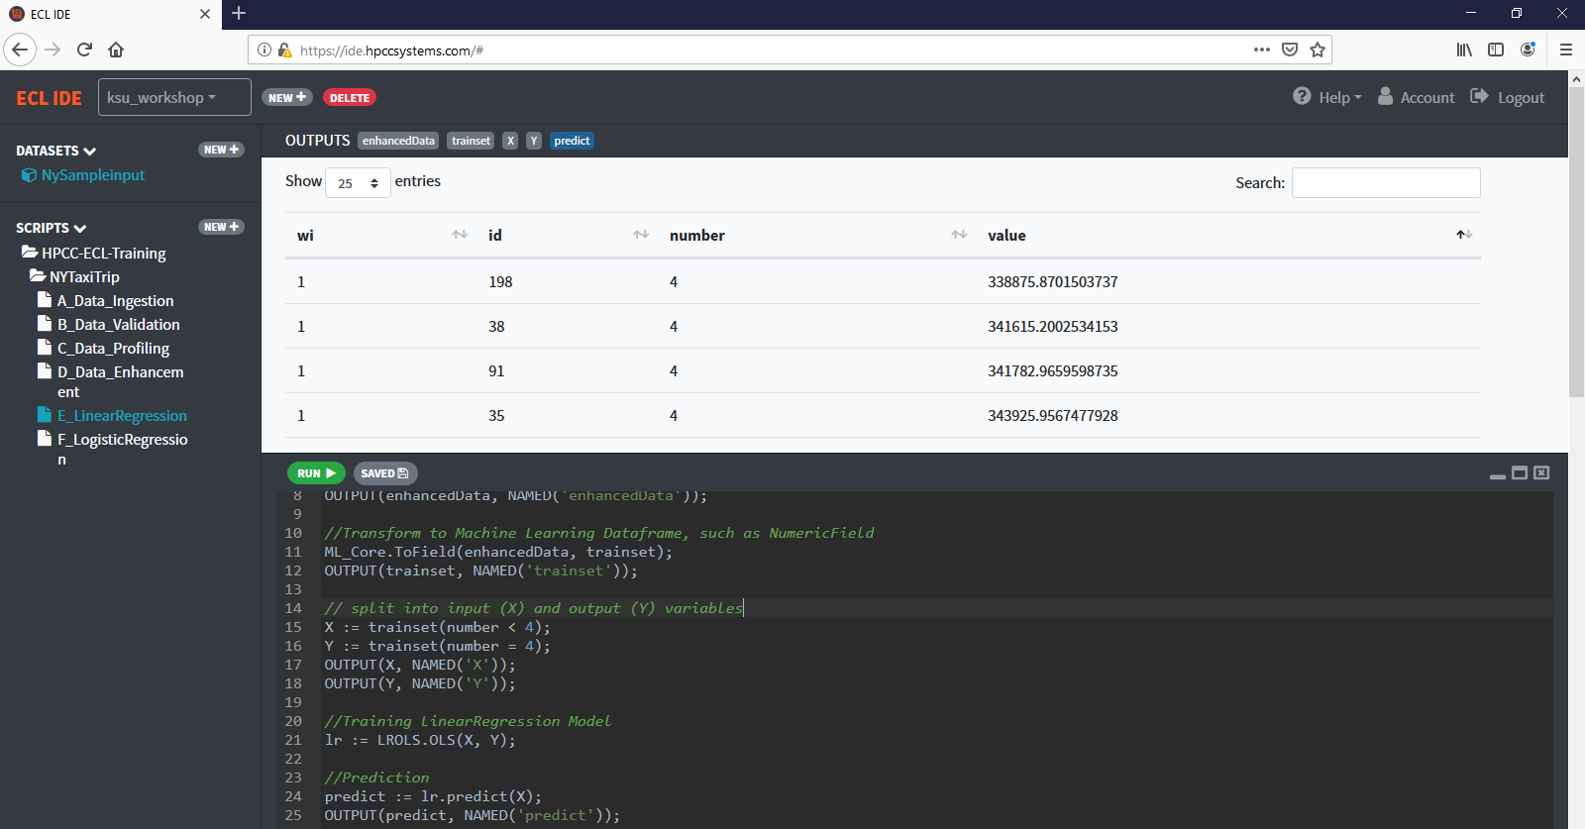
Linear Regression

Slide 31
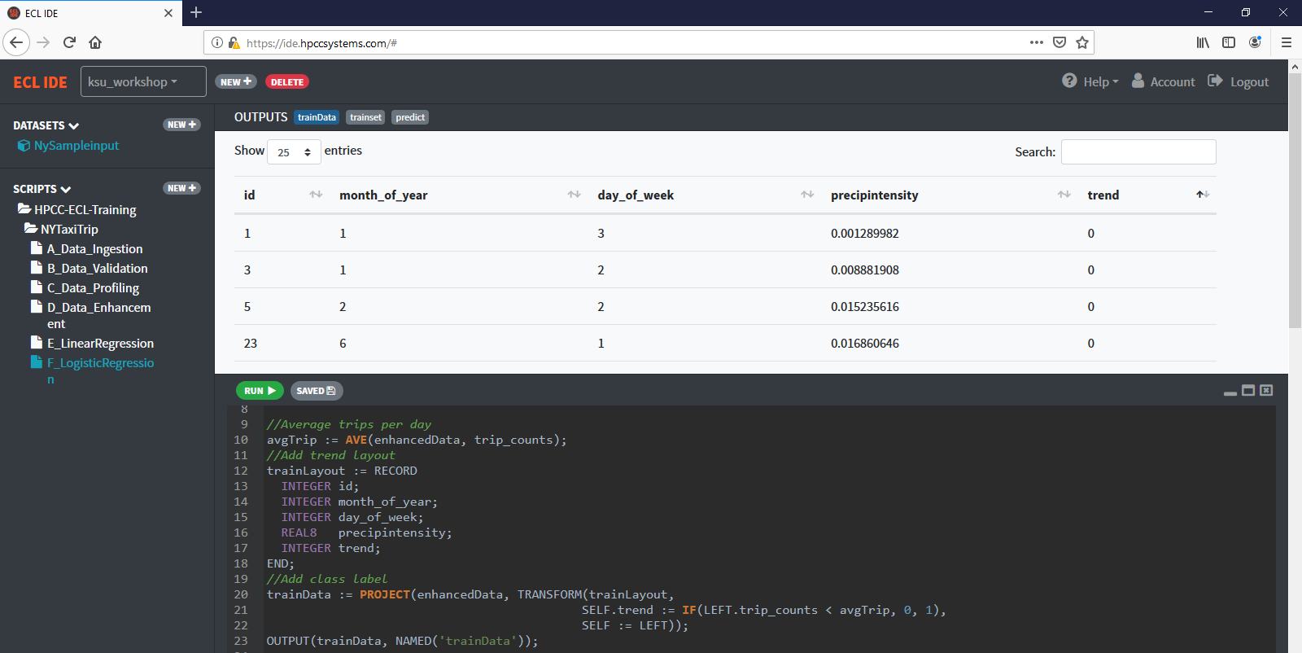
Logistic Regression

Slide 32
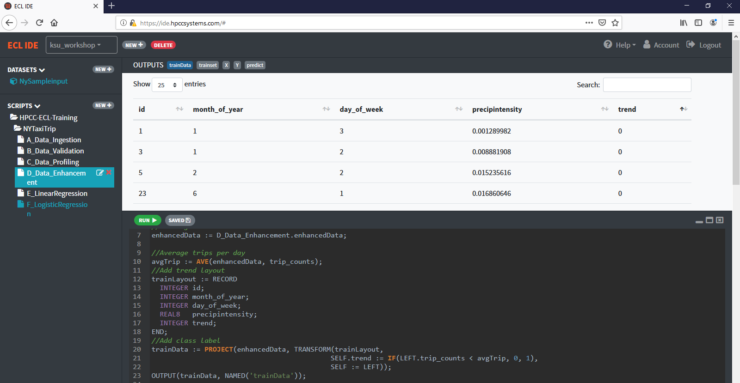
Logistic Regression

Slide 33
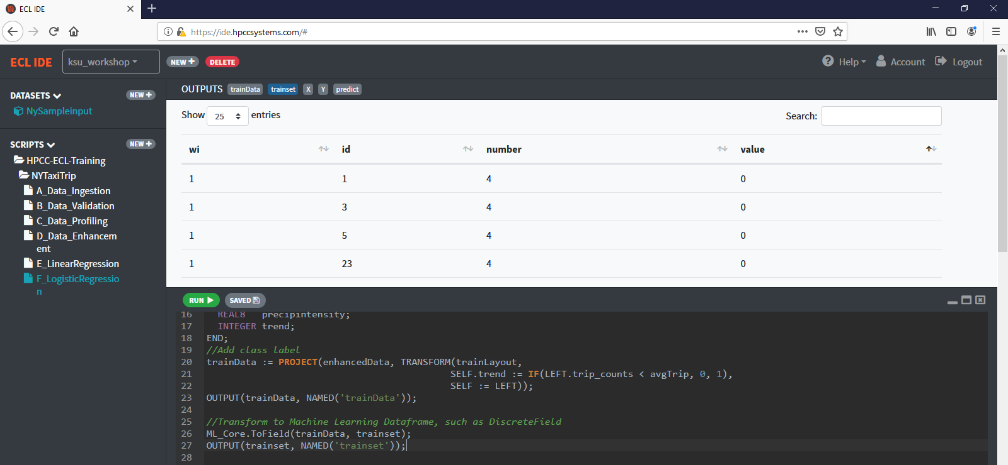
Logistic Regression

Slide 34
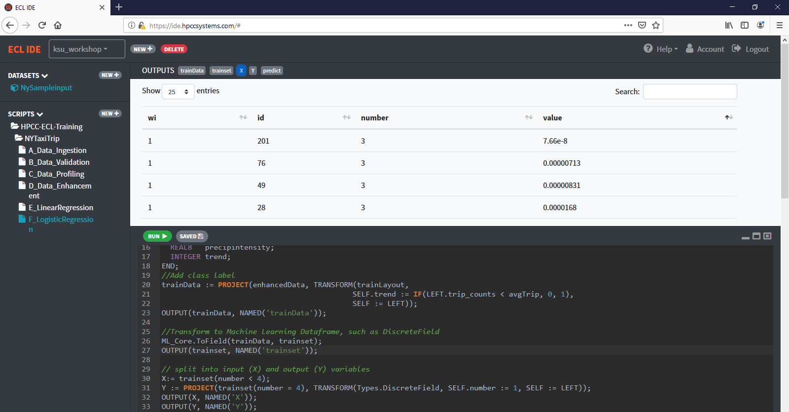
Logistic Regression

Slide 35
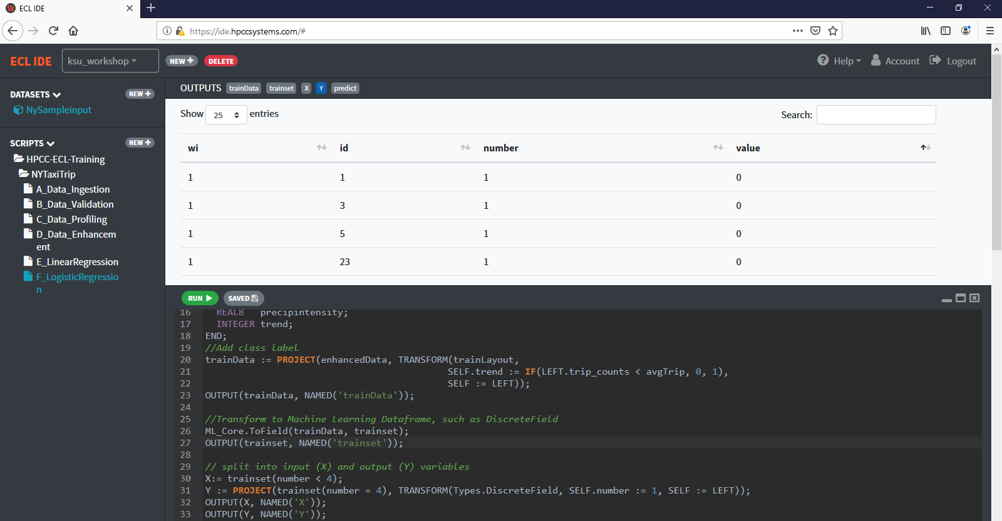
Logistic Regression

Slide 36
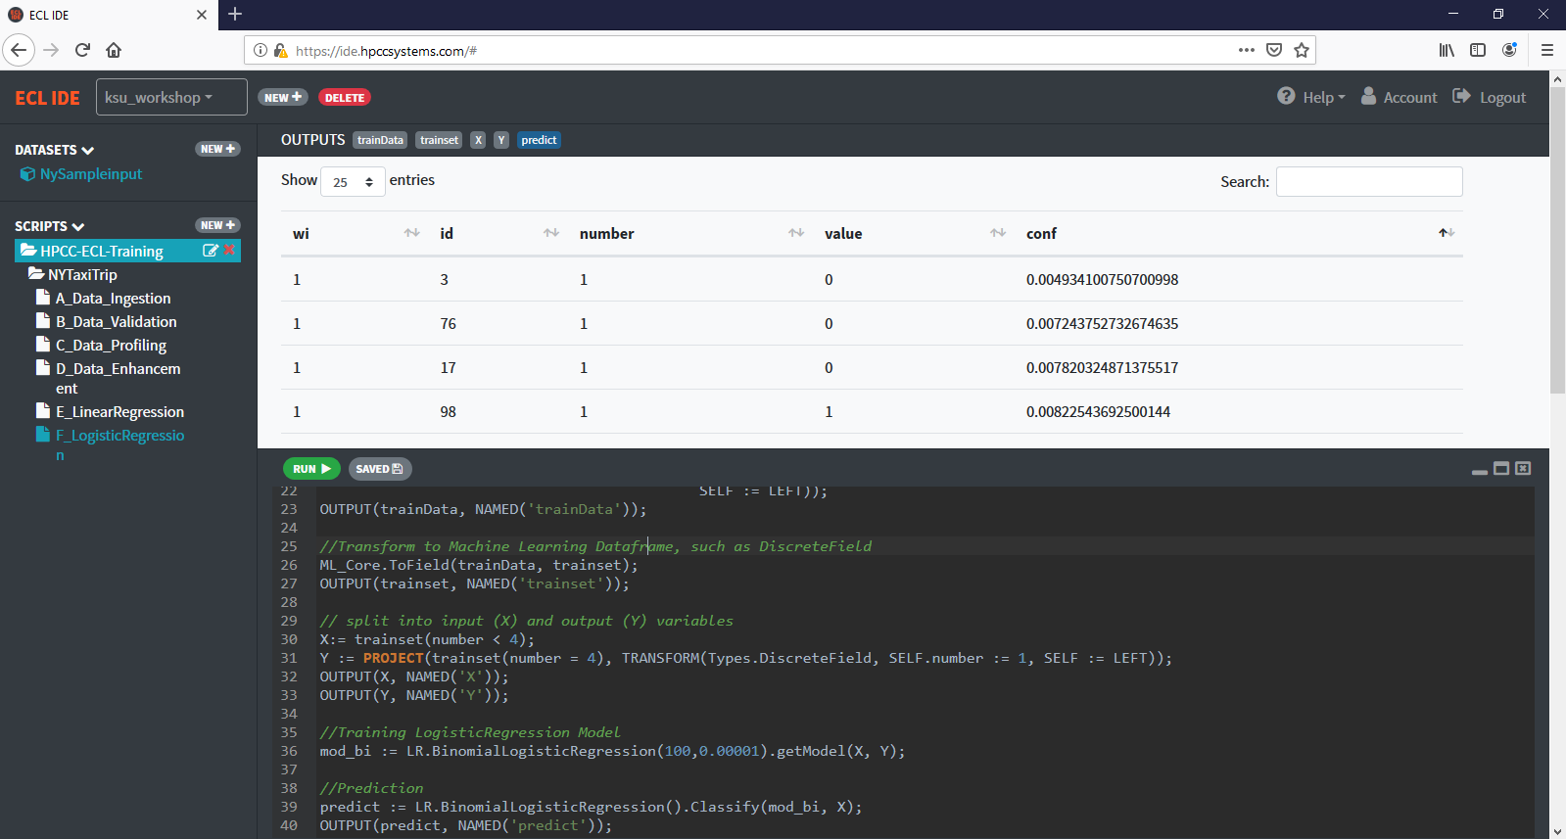
Logistic Regression

Slide 37


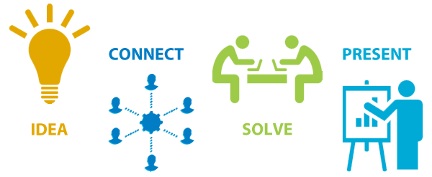



HPCC Systems KSU Hackathon 2019
https://hpccsystems.com/hpccsummit2019

Slide 38

Before Hackathon
Register ECL Cloud IDE on Campus https://ide.hpccsystems.com/auth/login​​​​​​​
Try the NY Taxi Trip Tutorial in ECL Cloud IDE
https://github.com/lilyclemson/KSU_Hachathon2019

Slide 39
More Information
Introduction of HPCC Systems Machine Learning Library
HPCC Systems Machine Learning Library on Github
Myriad Interface Tutorial
HPCC-Systems-Summit-2019

Slide 40
Appendix
This tutorial is based on a sample set of the original data.
For the complete information about the original tutorial, please see details in below Github Repository
https://github.com/lilyclemson/Solutions-ECL-Training/tree/master/Taxi_Tutorial

